Slide 1
Comparative analysis of machine learning methods for analyzing security practice in electronic health records’ logs.

Slide 2
Background
Analysing security practice in big data context

Slide 3
Methods

Slide 4
Health record logs data simulation
We simulated a one-year access log data of the hospital information system from 01 January 2019 until 31 December 2019.
simulated five main modules of EHR: Report, Finance, Patient Management, Laboratory Management, and Pharmacy Management

Slide 5
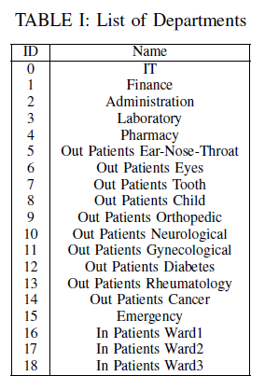

Slide 6
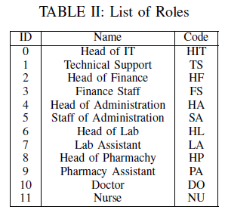

Slide 7
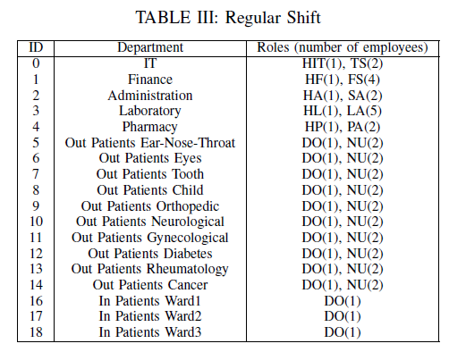
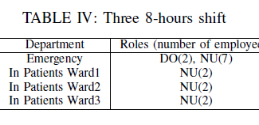

Slide 8
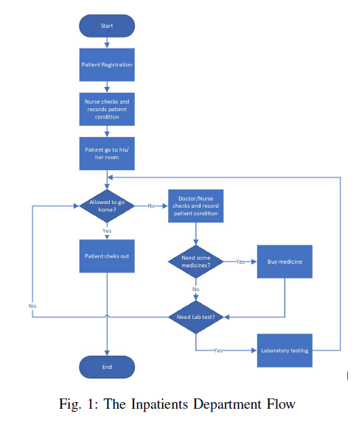
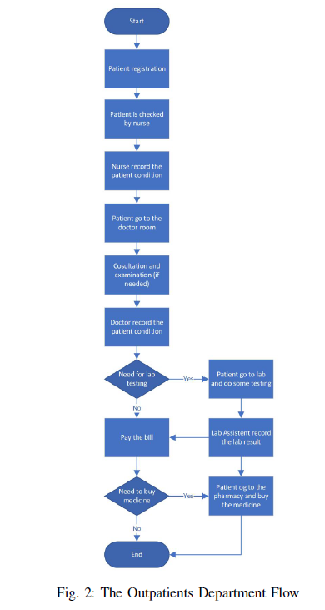

Slide 9
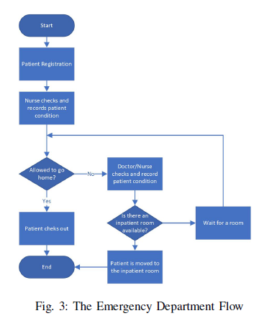

Slide 10
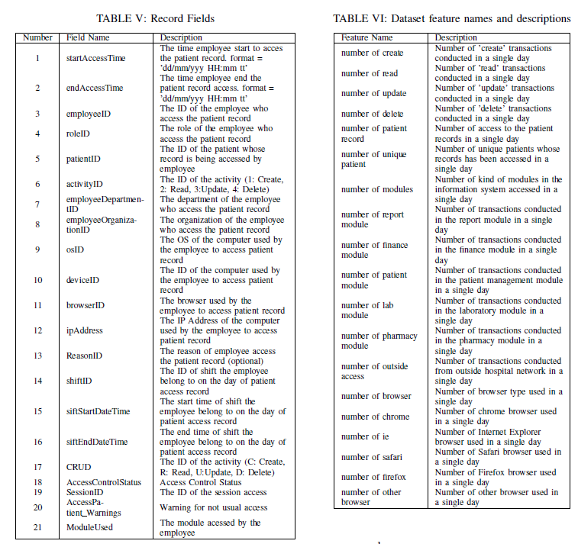

Slide 11


Feature Extraction:

Slide 12

Normal data
The normal data are all the instances in which all access logs are in line with the roles and flows.

Slide 13
Abnormal data
The definition of anomaly data here is :
all the instances had at least one fraudulent log access in a single day
Fraudulent access:
attackers that are assumed have compromised some users credential and use it to access patients records (e.g. identity theft).
The attacker will access more data than legitimate users
sometimes not follow the flows.
accessing more data,
accessing patients outside their sift,
using different browser,
accessing modules outside their roles

